Slide 1
2.1.3 Geometric interpretation of real 2- and 3-dimensional vectors

Slide 2
Introduction
In this topic, we will
Look at geometric interpretations of 2-dimensional vectors
Consider geometric interpretations of 3-dimensional vectors

Slide 3
2-dimensional vectors
Real two-dimensional vectors can be interpreted as points on a plane
Generally, the axes are labeled x and y
2-d vectors are interpreted as coordinates in the x-y–plane
The first entry corresponds to the x coordinate
The second entry corresponds to the y coordinate

Slide 4
2-dimensional vectors
We may or may not
Put labels on the axes
Put arrow heads on the axes
You should understand the significance of the positions
Unnecessary ink on a graphic that does not help comprehension is referred to by Tufte as chartjunk
In some cases, if the actual values don’t matter, we may not even include the tick marks and labels

Slide 5
2-dimensional vectors
Here are two examples
The zero vector is at the intersection of the axes

Slide 6
3-dimensional vectors
Real three-dimensional vectors can be interpreted as points in space
Generally, the axes are labeled x, y and z
3-d vectors are interpreted as coordinates in 3-space
The orientation of the positive x-, y- and z-axes depends on the right-hand rule

Slide 7
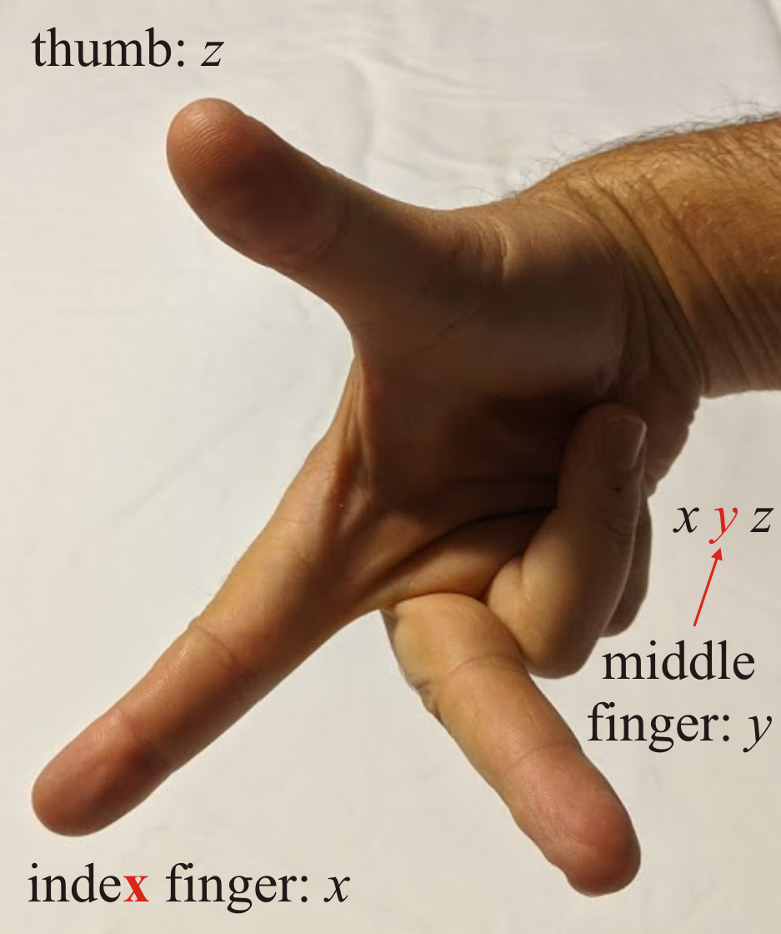
3-dimensional vectors
The right-hand rule indicates the directions of the positive x-, y- and z-axes using the index and middle fingers and the thumb:

Slide 8
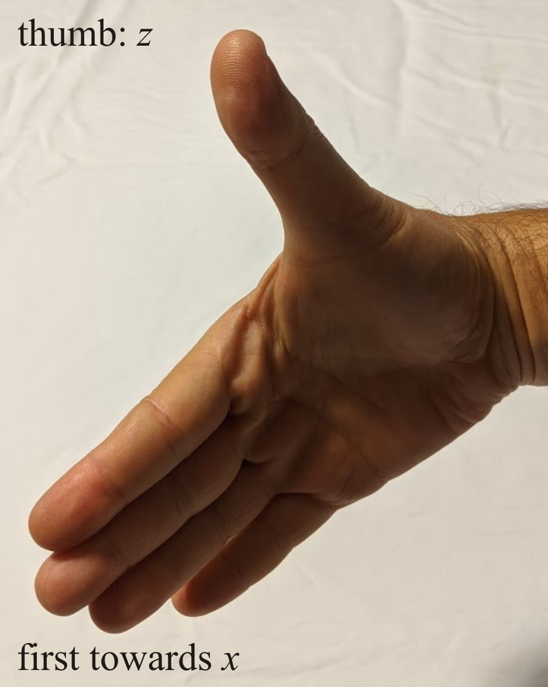
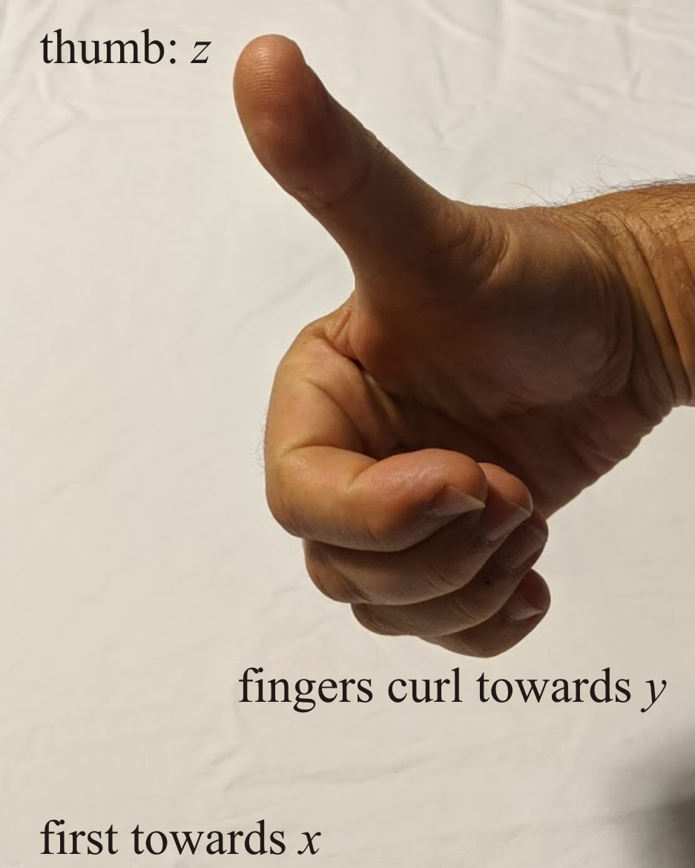
3-dimensional vectors
Alternatively, if the thumb points in the direction of positive z,
and the fingers point in the direction of positive x,
curling the fingers moves towards positive y

Slide 9
3-dimensional vectors
Visualizing a point in 3-space can be more challenging
It requires visual cues
v

Slide 10
3-dimensional vectors
Visualizing a point in 3-space can be more challenging
It requires visual cues
v

Slide 11
3-dimensional vectors
Visualizing a point in 3-space can be more challenging
It requires visual cues
v

Slide 12
3-dimensional vectors
Visualizing a point in 3-space can be more challenging
It requires visual cues
v

Slide 13
3-dimensional vectors
Visualizing a point in 3-space can be more challenging
It requires visual cues
v

Slide 14
Summary
Following this topic, you now
Seen interpretations of 2-dimensional vectors
Seen interpretations of 3-dimensional vectors
Are aware of the right-hand rule for the axes is 3-space

Slide 15
References
[1] https://en.wikipedia.org/wiki/Linear_algebra

Slide 16
Acknowledgments
None so far.

Slide 17
Colophon
These slides were prepared using the Cambria typeface. Mathematical equations use Times New Roman, and source code is presented using Consolas.
The photographs of flowers and a monarch butter appearing on the title slide and accenting the top of each other slide were taken at the Royal Botanical Gardens in October of 2017 by Douglas Wilhelm Harder. Please see
https://www.rbg.ca/
for more information.

Slide 18
Disclaimer
These slides are provided for the ne 112 Linear algebra for nanotechnology engineering course taught at the University of Waterloo. The material in it reflects the authors’ best judgment in light of the information available to them at the time of preparation. Any reliance on these course slides by any party for any other purpose are the responsibility of such parties. The authors accept no responsibility for damages, if any, suffered by any party as a result of decisions made or actions based on these course slides for any other purpose than that for which it was intended.

